Slide 1

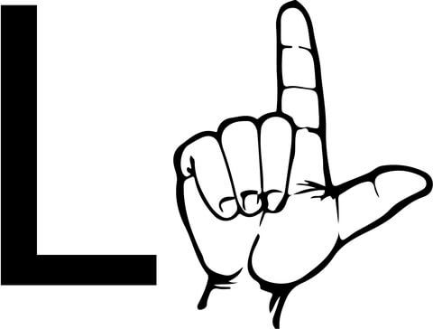
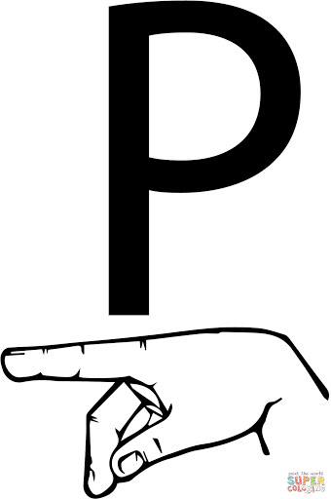
Speech to Indian Sign Language translator
Nimish K. Aggarwal – 19BCE0014 (Group Leader)
Vrushali Deshmukh – 19BCE0033
Tarang Garg – 19BCE0053
Mohit Keyal – 19BCE2603
Aviral Goyal – 19BCE0883

Slide 2
ABOUT THE PROJECT
According to an independent census, there are about 700,000 – 800,000 mute people in the world out of which thousands live in India. Quite often, these people also suffer from hearing impairments. Therefore, the only means of communication for them is the Sign Language which is not very popular. This makes life harder for the people who suffer from this disability.
Our aim is to integrate our knowledge of Computer Sciences with this issue and create a program that will take the audio of the speaker as input, and show the hand signs of the Indian language according to the audio. This will help make communication easier, and it will do away with the need of us learning the sign language.
The project will use python language and will take audio input using PyAudio.

Slide 3
TOOLS EMPLOYED
An application which takes in live speech or audio recording as input, converts it into text and displays the relevant Indian Sign Language images or GIFs.
Front-end using EasyGui.
Speech as input through microphone using PyAudio.
Speech recognition using Google Speech API.
Text Preprocessing using NLP.
Dictionary based Speech to Sign language Translation.
Implementation in Visual Studio

Slide 4
CODE
import speech_recognition as sr
import numpy as np
import matplotlib.pyplot as plt
import cv2
from easygui import *
import os
import nltk
from PIL import Image, ImageTk
from itertools import count
import tkinter as tk
import string
#import selecting
#obtain audio from the microphone
def func():
r = sr.Recognizer()
arr=['a','b','c','d','e','f','g','h','i','j','k','l','m','n','o','p','q','r', 's','t','u','v','w','x','y','z’]

Slide 5
with sr.Microphone() as source:
r.adjust_for_ambient_noise(source)
i=0
while True:
print("I am Listening")
audio = r.listen(source)
try:
a=r.recognize_google(audio)
a = a.lower()
print('You Said: ' + a.lower()) for c in string.punctuation:
a= a.replace(c,"") if(a.lower()=='goodbye' or a.lower()=='good bye' or a.lower()=='bye’): print("oops!Time To say good bye")
break
else:
for i in range(len(a)): if(a[i] in arr):

Slide 6
ImageAddress = 'letters/'+a[i]+'.jpg' ImageItself = Image.open(ImageAddress) ImageNumpyFormat = np.asarray(ImageItself) plt.imshow(ImageNumpyFormat)
plt.draw()
plt.pause(0.8)
else:
continue
except:
print(" ")
plt.close()
while 1:
image = "signlang.png"
msg="HEARING IMPAIRMENT ASSISTANT"
choices = ["Live Voice","All Done!"] reply = buttonbox(msg,image=image,choices=choices)
if reply ==choices[0]:
func()
if reply == choices[1]:
quit()

Slide 7

OUTPUT

Slide 8
PENDING TASKS
Addition of a new function wherein when a specific input in the form of a phrase is given to the system as audio, the output will be a GIF that translates the entire phrase into sign language instead of letter-by-letter plotting on the graph as seen in the output from previous slide.
For this function, we will program certain phrases ourselves that the system will recognize later on in case a similar phrase is given as audio.
This will not only fasten the system, but will also be user friendly.
This feature will be added to the program before Review III.

Slide 9
GOOGLE DRIVE LINK
https://drive.google.com/file/d/1rvwAuO8hcIHDG_9ZwKym9KPOAEDHO_cw/view?usp=sharing

Slide 10
THANK YOU!

